Slide 1

NEXT GEN EMPLOYABILITY PROGRAM CREATING A PPT FOR MUSIC APPLICATION Student Name: SURAJ College Name: NETAJI SUBHASH UNIVERSITY OF TECHNOLOGY, Dwarka, Delhi Student ID: STU62de132b9ab1c1658721067

Slide 2
Project Title Music Web Application using Django Framework (FSWD) Abstract | Problem Statement | Project Overview | Proposed Solution | Technology Used | Modelling & Results | Conclusion | Q&A

Slide 3
Abstract 1. Explore the utilization of Django, a powerful Python web framework, in the development of music web applications. 2. Highlight the key features and benefits of Django that make it an ideal choice for building dynamic and scalable platforms. 3. Emphasize the importance of these features in providing a seamless and enjoyable user experience for music enthusiasts. 4. We'll delve into the essential features of our Music Web App, emphasizing user authentication, music streaming capabilities, playlist management functionalities, and advanced search options.

Slide 4
Problem Statement In today's digital landscape, music enthusiasts seek immersive and personalized experiences through online platforms. However, existing music streaming services often lack the flexibility and customization options desired by users. Additionally, developers face challenges in creating dynamic web applications that seamlessly integrate frontend and backend components while ensuring scalability and performance.
To address these challenges, there is a need to develop a robust Music Web Application that leverages the Django framework to provide a comprehensive solution for music lovers. This application should offer advanced features such as user authentication, music streaming, playlist management, and efficient search functionalities, all within an intuitive and user-friendly interface.

Slide 5
Project Overview The Music Web Application project aims to develop a comprehensive platform for music enthusiasts, leveraging the Django framework to deliver a seamless and personalized user experience. This application will provide advanced features such as user authentication, music streaming, playlist management, and efficient search functionalities, catering to the diverse needs of users.
By developing a Music Web Application with Django, the project aims to provide a versatile and scalable platform that redefines the way users discover, stream, and interact with music online, setting a new standard for excellence in web application development.

Slide 6
Proposed Solution 1.User Authentication and Profile Management:
Users can create accounts, log in securely, and manage their profiles.
Personalized user profiles allow users to track their listening history, favorite artists, and playlists.
Music Streaming:
Extensive library of songs spanning various genres, artists, and albums.
Seamless streaming experience with high-quality audio playback.
Playlist Creation and Management:
Users can create custom playlists, add or remove songs, and reorder tracks according to their preferences.
Collaborative playlist feature enables users to share and collaborate on playlists with friends.
Advanced Search Functionality:
Robust search capabilities allow users to discover music by genre, artist, album, or song title.

Slide 7
Technology Used Django Framework:
Django serves as the backbone, providing a robust and scalable framework for web application development.
Utilizes Django's built-in features for URL routing, template rendering, and ORM for database interactions.
Python Programming Language:
Python is the primary programming language used for backend development.
Leveraged for implementing business logic, data processing, and integrating third-party APIs.
HTML5, CSS3, JavaScript:
HTML5, CSS3, and JavaScript are used for frontend development to create responsive and interactive user interfaces.
Employ modern CSS frameworks like Bootstrap or Tailwind CSS for styling and layout design.
PostgreSQL Database:
PostgreSQL is chosen as the relational database management system (RDBMS) .
Utilized for storing user data, music metadata, playlists, and other application-related information.
Django REST Framework (DRF):
DRF is used to build RESTful APIs for communication between the frontend and backend components.
Enables seamless integration with frontend frameworks and facilitates data exchange in JSON format.

Slide 8
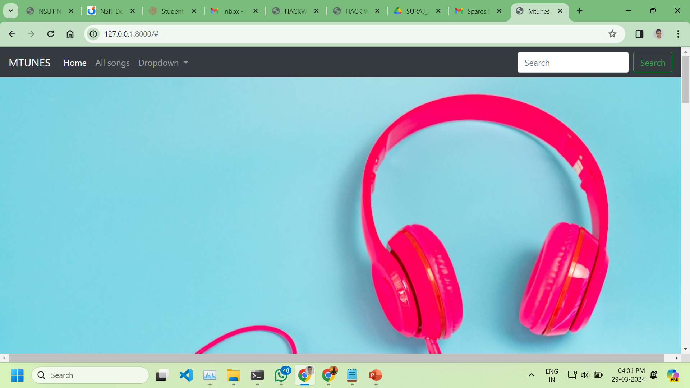
Modelling & Result

Slide 9
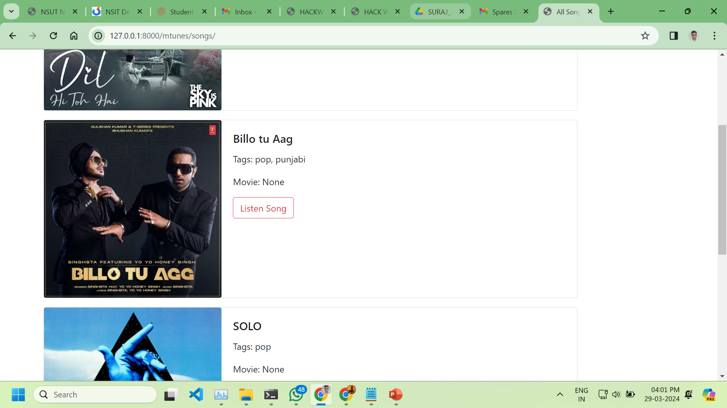
Modelling & Result

Slide 10
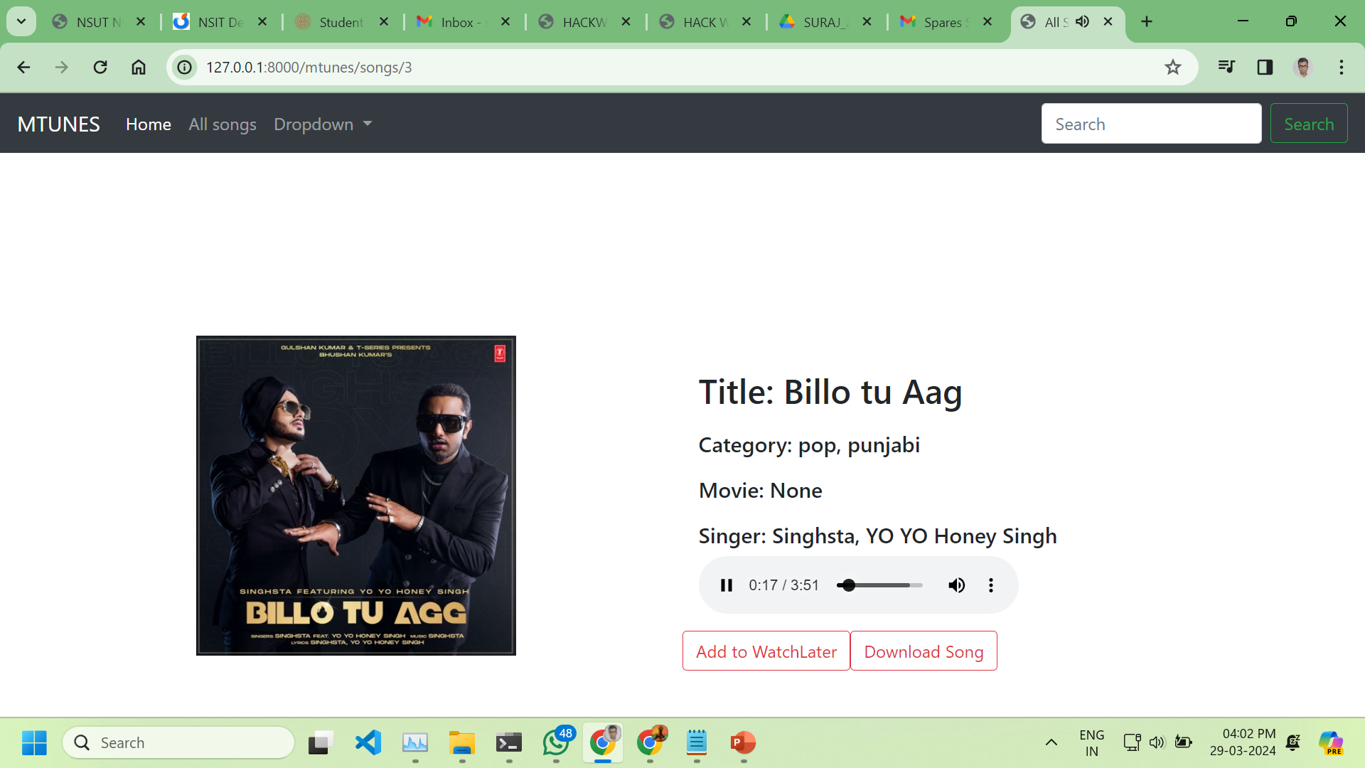
Modelling & Result

Slide 11
Conclusion In conclusion, Music Web Application represents a cutting-edge solution for music enthusiasts, offering a feature-rich and immersive music streaming experience powered by Django and a modern technology stack. Throughout this project, we have demonstrated the versatility and power of Django in building dynamic web applications, showcasing its ability to seamlessly integrate frontend and backend components while ensuring scalability, performance, and security.
With Music Web Application, users can discover new music, stream their favorite songs, create personalized playlists, and engage with a vibrant music community all within a sleek and intuitive interface. By leveraging advanced features such as user authentication, music streaming, playlist management, and search functionality, Music Web Application sets a new standard for excellence in the realm of music web applications.

Slide 12
Thank you
AICTE Student ID: STU62de132b9ab1c1658721067
AICTE Internship ID: INTERNSHIP_170003939765548ae545859

